Slide 1
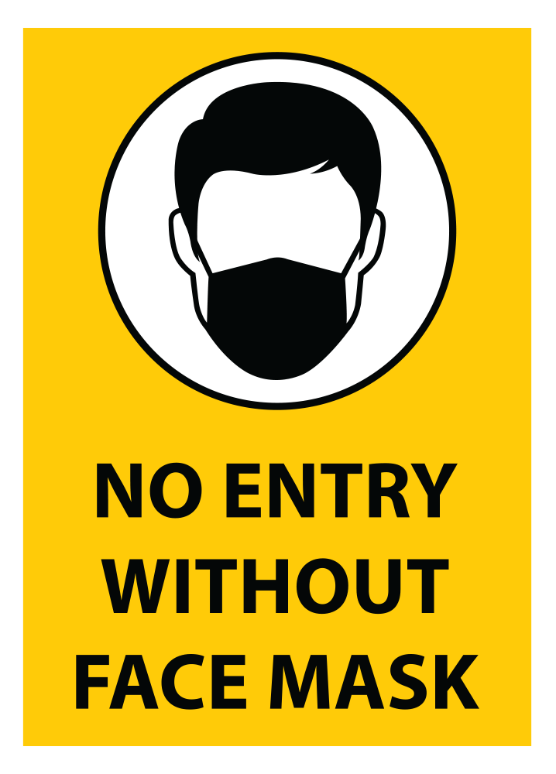
Face Mask Detection

Slide 2
About Us
ADDAGIRI NAGA RAKESH BT17GCS003 D3
CHENNUPATI SAI REVANTH BT17GCS152 D3
HITESH PARA BT17GCS154 D2
YENDURI SASANK BT17GCS124 D2

Slide 3
Index
Introduction
Motivation
Work done
Application of your project
Conclusion

Slide 4
Introduction
The Corona Virus has affected the world very seriously. One major protection from that virus is to wear a Face Mask. Due to this unimaginable situation wearing the Face Mask has been a new norm and compulsory. At present there are people assigned to check if everyone is wearing a face mask or not. But with our neural network model it can detect if people are wearing a mask or not in a Live video stream. For that we designed an efficient and accurate neural network model that can detect if a person is wearing face mask or not.

Slide 5
Motivation
“Many people are neglecting to wear a face mask. So, we decided to make a face mask detector which can detect if a person is wearing a mask or not.”

Slide 6
Project Plan
We divided the project into four phases and worked accordingly.
Initiation
Data Pre-Processing
Training the Model
Testing the Model

Slide 7
1.Intiation:
We read a Research paper together
Gathered Dataset
Read about different neural network models
Finalized what classifiers we are going to use and number of layers we will use for creating the neural network model

Slide 8
2.Data Pre-processing:
We used Data Augmentation techniques to multiply the images
We converted all the images into arrays. So with that arrays we are creating a model
Resized all the images into (224x224)
Performed one-hat encoding on the labels of images
And we used test_size=0.20, which means 20% of images in the dataset will go to testing set and the remaining will go into training set.

Slide 9
3. Training the Model:
Input
Mobile Net
Output
Pooling
Fully Connected

Slide 10
Training the Model:
Initializing learning rate is 0.0001 and epochs to be 20
We create base model using mobilenetv2 classifier and passing that output into normal model.
We used Average Pooling to extract the features and created a pool of size (7,7)
We are going to flatten them and send to the Fully Connected Layer.

Slide 11
Training the Model:
After we adding a dense layer with 128 neurons and activation as “Relu” and use dropout to just avoid over fitting
After we are creating another layer with 2 neurons and activation as “Softmax”
Fitting our model into data and save this model in a H5 format for further use.
Plotting the graph between accuracy and training loss.

Slide 12
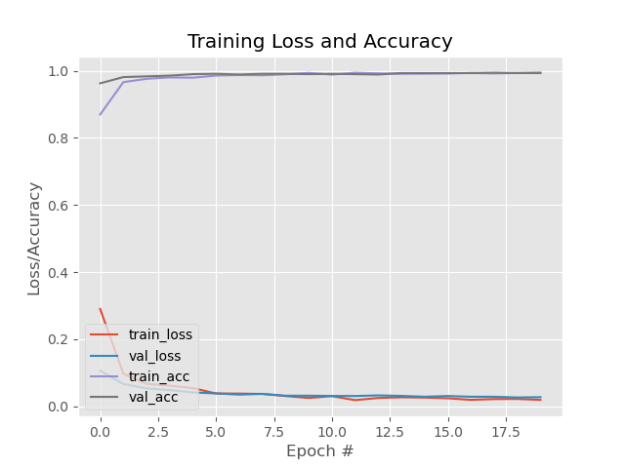

Slide 13
4. Testing the Model:
In this phase we are testing the model that we have trained in the previous phase. We used OpenCV, a python library, for integrating the Live video stream into our project.
The model will predict the possibility of two class Mask and NoMask. If the person in the live video is wearing a Mask then it will detect the face of the person and shows a square in green colour with heading Mask and if the person is not wearing a mask then it will show the persons face in a red square with accuracy and No Mask

Slide 14
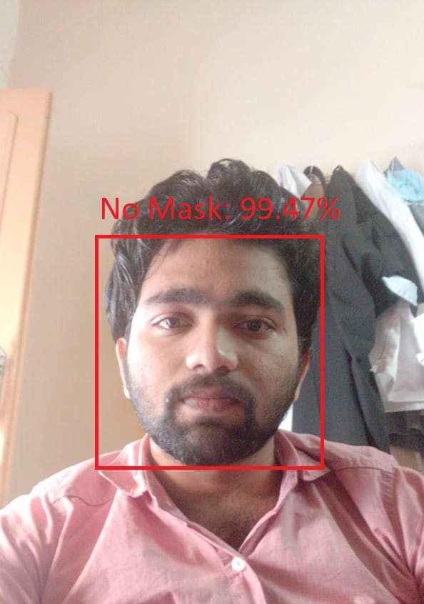
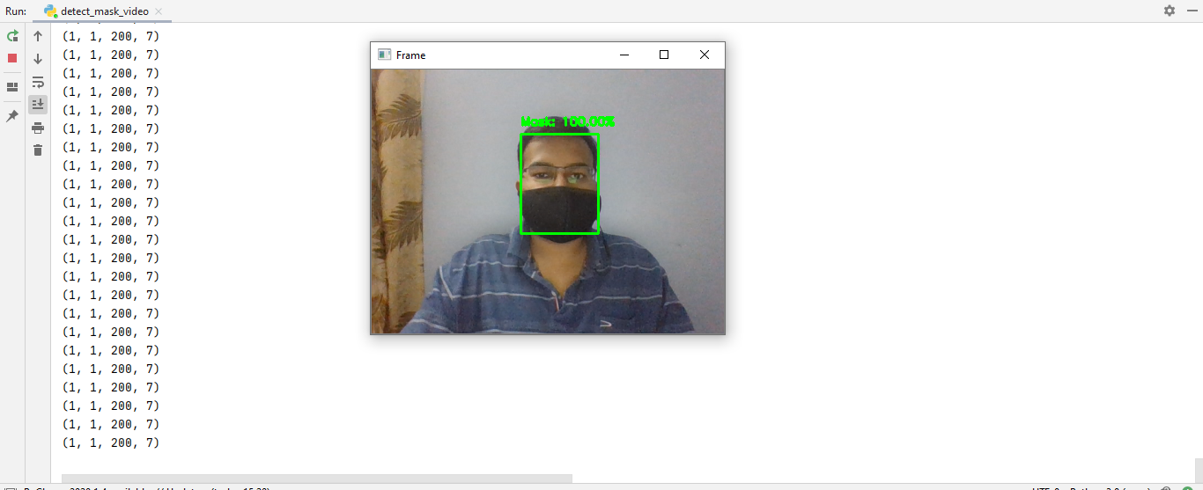
Output

Slide 15
Application of our Project

Slide 16
We have developed a face mask detector on images. And in excess we also developed a model which can be applied to Live Video Streams to detect if the person in the frame are wearing a mask or not.
With some additional improvements and additions our neural network model can be integrated with CCTV to detect and identify people without masks in Public places.

Slide 17
Conclusion

Slide 18
Our neural network model is developed using libraries like Keras, TensorFlow, Mobile Net and OpenCV. It uses AveragePooling2D, Flatten, Dense and Dropout as the layers in the network. It can detect and identify people without masks. Our model is accurate, and since the MobileNetV2 classifier is used, it is also computationally efficient and thus making it easier to deploy the model to embedded systems (Arduino, RaspberryPi, etc.).
So, it can also be used in real-life applications which require face mask detection for safety purposes due to Covid-19.
This model can be integrated with embedded systems in public places like Airports, Railway stations, Bus stations, Offices, Schools, Hospitals, etc.

Slide 19

Thanks!

